Slide 1
The Probation Service and Irish Prison Service Introduction JUST/2011-2012/JPEN/AG/2943 Release and Resettlement of High Risk Prisoners
Florence December 2012

Slide 2
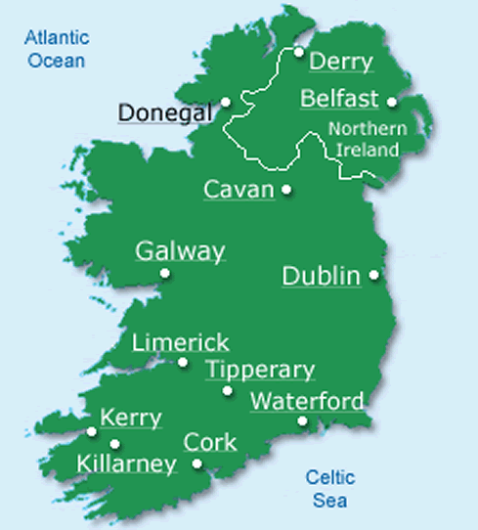
The Probation Service
Agency of the Department of Justice and Equality
Adult and children community sanctions and post-custody supervision
Over 400 staff
National service
Budget of €40 million
Network of 62 community based organisations
15,000 offenders in community annually

Slide 3
The Probation Service – what we do
Two main areas of work
Assessment
Courts
Parole Board
Department of Justice and Equality
Irish Prison Service
Risk Assessment tools
e.g. LSI-R, YLS-CMI, S&A
LSI-R Profile October 2012
Low Mod High V.High
10.2% 56.6% 27.7% 5.6%
2. Supervision and Rehabilitation of offenders:
Probation type supervision
Community Service
Life sentence and other ex-prisoners
Sex offenders & high risk offenders

Slide 4
Irish Prison Service
The Irish Prison Service deals with male offenders who are 17 years of age or over and female offenders who are 18 years of age or over.
The Irish Prison Service operates as an executive agency within the Department of Justice and Equality

Slide 5
Irish Prison Service
14 Prisons
Irish Prison Service operating budget for 2012 is €312m
Prisoners
2007 - 3,321 prisoners
2011 4,389 prisoners (an increase of over 32%)
Committals
2007 11,934
2011 17,318 (an increase of over 45%)

Slide 6
IPS- Integrated Sentence Management (ISM)
A prisoner-centred, multidisciplinary approach to working with prisoners with provision for initial assessment, goal setting and periodic review to measure progress.
Newly committed prisoners with a sentence of greater than one year are eligible to take part in ISM.
Personal Integration Plan (PIP) - a plan of actions for the prisoner to complete during his/her time in prison.

Slide 7
Our Key Partnerships

Slide 8
Court mandated supervision
Courts have authority in sentencing to mandate post-sentence Probation Service supervision of certain prisoners.
Part or fully suspended sentences (CJA 2006)
Post custody supervision of scheduled sex offenders (SOA 2001)

Slide 9
Temporary Release
Criminal Justice Act, 1960 as amended by the Criminal Justice (Temporary Release of Prisoners) Act, 2003) authorises the Minister for Justice and Equality to release prisoners for specific periods for purposes including:
assessing the person’s ability to reintegrate into society upon such release,
preparing him/her for release upon the expiration of his sentence of imprisonment
Resettlement and reintegration

Slide 10
The Parole Board.
Interim Parole Board established 2001
Advises the Minister for Justice and Equality on the administration of long-term prison sentences.
Reviews the cases of prisoners sentenced to determinate sentences of eight years or more.
The final decision regarding the recommendations of the Parole Board lies with the Minister, who can accept them in their entirety, in part or reject them.

Slide 11
www.probation.ie
Probation Service, Haymarket, Smithfield, Dublin 7.
Tel: + 353 (0)1 817 3600
Fax: + 353 (0)1 872 2737
www.irishprisons.ie
IDA Business Park, Ballinalee Road, Longford, Co. Longford
Tel: +353 43 33 35100
Fax: +353 43 33 35371

